Slide 1

HealthCare Capstone Project

Slide 2
Agenda
Objective
Background
Key Findings
Patterns and trends
Correlation Analysis
Model Evaluation
Recommendations
Appendix
Data Methodology

Slide 3
Objective
To identify and create a dataset out of the multiple hospital documents which helps in star rating calculation.
To build a rating prediction model and determine the factors that are impacting the rating.
To predict the Evanston hospital rating using the model and recommend the measures they need to concentrate on to improve the hospital rating.

Slide 4
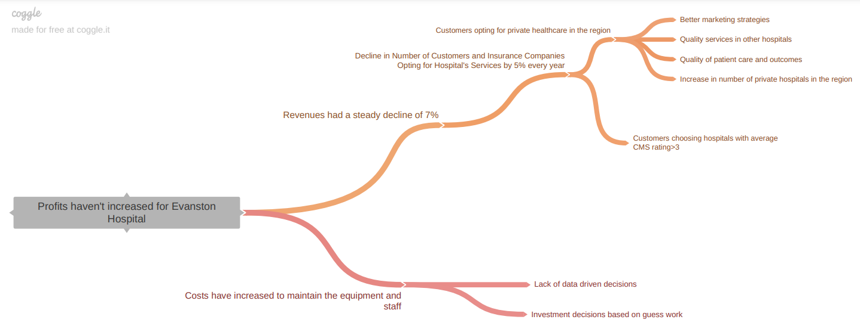
Background
Evanston Hospital’s net profit has had a steady decline of around 7% for the last 6 quarters
Taking decisions through guesswork and spending amount on improving its services has led to decline in revenue.
The hospital is not being able to improve its rating even after the improvements. It is not aware of the factors that are possibly affecting its rating significantly.

Slide 5
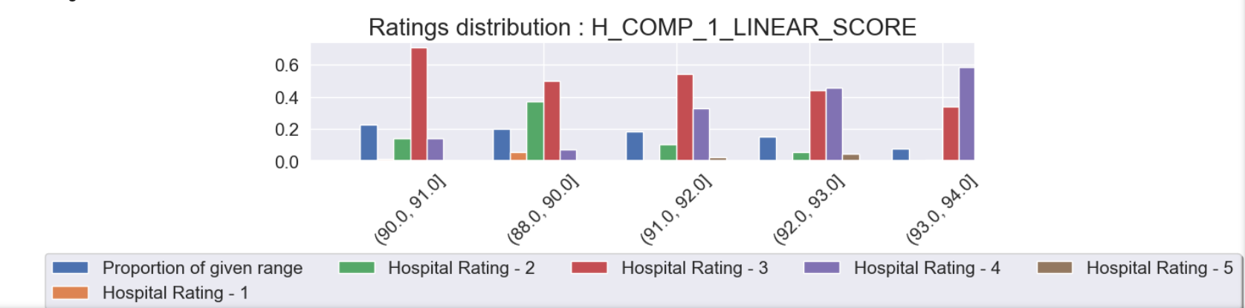
Key Findings
Using Information value was able to find the top 10 impacting features and the relationship they have with the hospital rating.
Hospital ratings is imbalanced with 49% of the data having rating 3, So we need to used sampling techniques during modelling
When the Nurse Communication Linear mean score is in the range 92 -94, the hospitals are getting rating 4 and above but most of the score lies in between 88-91 causing more ratings to be 2 and 3

Slide 6
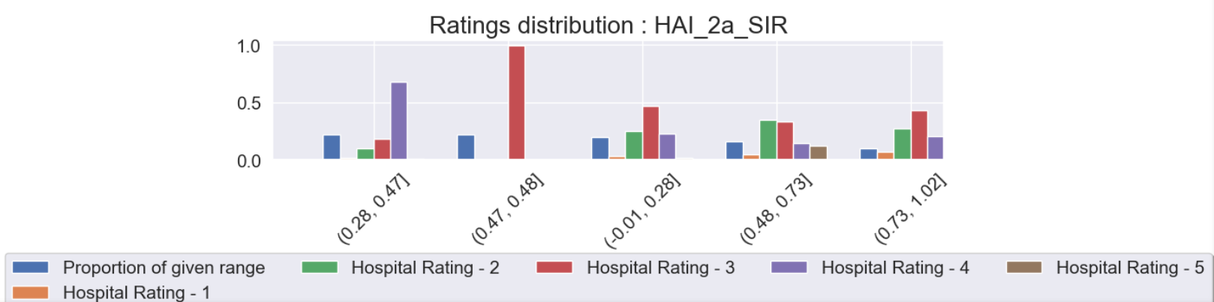
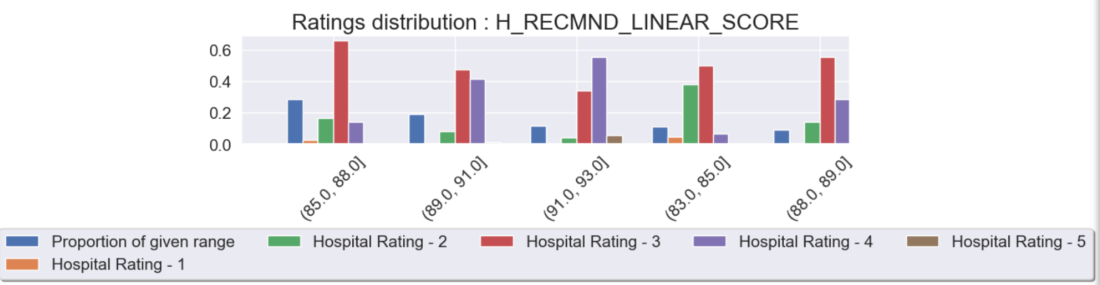
Key Findings
When the ‘Catheter-Associated Urinary Tract Infections (CAUTI) in ICUs only’ score is less i.e., in the range of 0.28-0.47, the hospitals are getting top ratings
When the Recommend Hospital Linear mean score is higher the hospital ratings are above 3

Slide 7
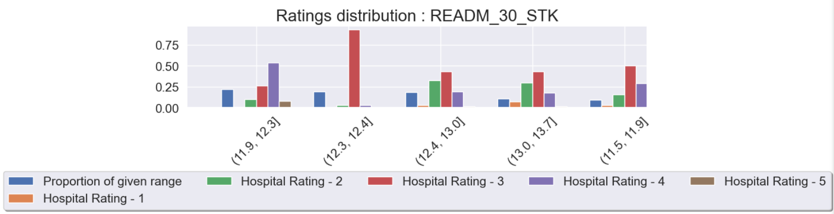
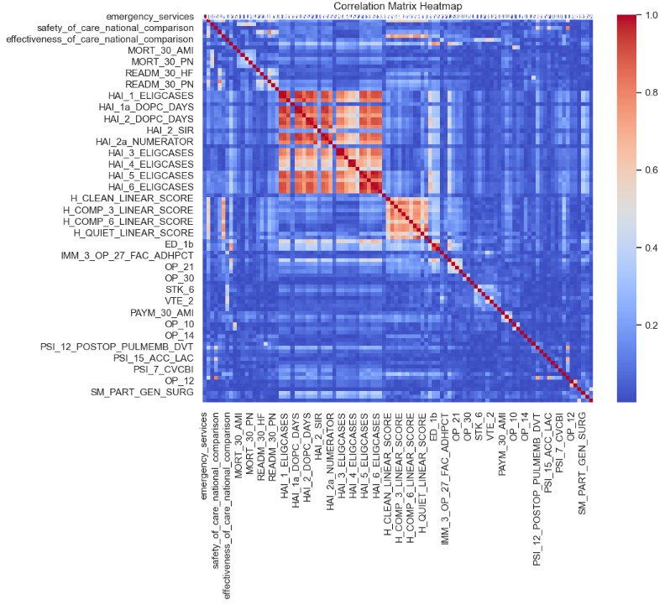
Key Findings
When we see the rate of admission for stroke patients in last 30 days is less i.e., in the range 11.9 – 12.3, the hospital ratings tend to be high.
Correlation Analysis
We could see that almost 26 features were having correlation score > 0.8. Removed these features before modelling.

Slide 8
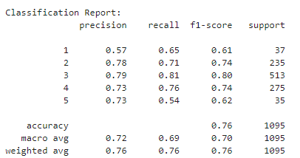
Model Evaluation
Used Logistic regression as base model as this is multi class target variable.
Used SMOTE sampling to overcome the imbalanced data.
Considering different performance metrics, Gradient Boost with RFE is chosen as the best model for this use case.
Gradient Boost with RFE
Model | Accuracy | Precision | Recall | F1-Score | AUC-ROC
Logistic Regression | 0.7 | 0.72 | 0.7 | 0.67 | 0.89
Logistic with Hyperparameter | 0.78 | 0.79 | 0.78 | 0.785 | 0.93
Decision Tree | 0.5 | 0.55 | 0.5 | 0.5 | 0.75
Randon Forest | 0.7 | 0.55 | 0.5 | 0.5 | 0.75
Gradient Boost | 0.756 | 0.75 | 0.756 | 0.75 | 0.9
GradientBoost with RFE | 0.76 | 0.76 | 0.76 | 0.76 | 0.75

Slide 9
Evanston Hospital Rating
Using Gradient Boost with RFE, was able to predict the Hospital Star Rating for Evanston Hospital with 76% accuracy
Predicted Star Rating: 1 Star (indicating areas of significant improvement needed).
Key Influencing Factors:
Pneumonia (PN) 30-Day Mortality Rate
Heart Failure (HF) 30-Day Readmission Rate
Nurse Communication Linear Mean Score
Rate of Complications for Hip/Knee Replacement Patients
Emergency Department Efficiency

Slide 10
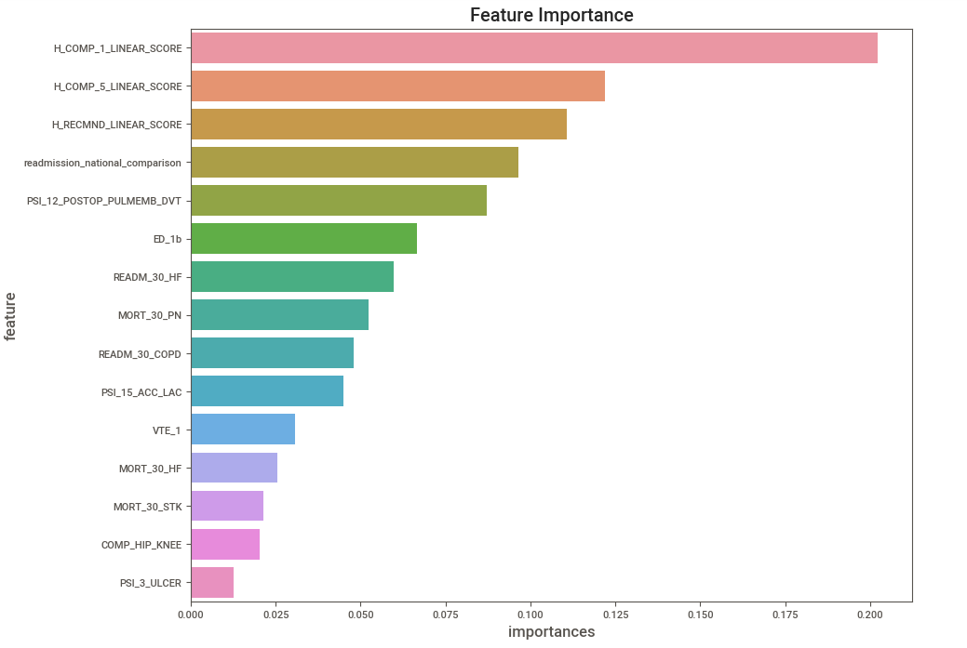
Feature Importance
Hospital Summary ratings hold most importance in which Nurse Communication tops and followed by Medicine Communication and recommend hospital ratings.
Readmission and Mortality scores are directly impacting the star rating. Below given are the impacting measures.
Pneumonia (PN) 30-Day Mortality Rate
Heart failure (HF) 30-Day Readmission Rate
Rate of readmission for chronic obstructive pulmonary disease (COPD) patients
Heart failure (HF) 30-Day Mortality Rate
Death rate for stroke patients

Slide 11
Recommendations
Enhance Management of Pneumonia and Heart Failure:
Improve early detection and treatment protocols for pneumonia and heart failure.
Implement comprehensive discharge planning and follow-up care programs to reduce 30-day mortality and readmission rates.
Reduce Readmission Rates for Chronic Conditions:
Develop outpatient support and monitoring systems for COPD patients.
Provide patient education initiatives to manage chronic conditions effectively.
Strengthen Stroke Care:
Invest in advanced stroke care training for emergency department staff.
Increase the availability of stroke rehabilitation services.
Improve Nurse Communication and Patient Recommendations:
Conduct regular training sessions to enhance nurse-patient communication.
Foster a culture of patient-centered care to improve overall patient experience and hospital recommendations.
Enhance Post-Operative Care to Reduce Complications:
Introduce stringent pre-operative and post-operative care protocols for hip/knee replacement patients.
Strengthen blood clot prevention protocols and ensure timely administration of anticoagulants post-surgery.

Slide 12
Appendix
Data Methodology
  Data Collection : Used the sheets which has hospital data, Considered the measures which affect the hospital rating. Pivoted the tables and merged them.
  Data Preprocessing : Imputed the missing values using mode for categorical features and mean for numerical features. Transformed the categorical features into numeric. Addressed the skweness in the features using log transformation and
  Univariate and Bivariate Analysis : Using Sweetviz analysed the individual features. Calculated IV for all the features and did bivariate analysis on the top 5 features with high IV value.
  Modelling techniques : Used Logistic, Random Forest, Gradient boost and RFE to select most importance features.
  Evaluation Metrics : Used Accuracy, Precision, Recall, AUC – ROC and classification report to analyze the model performance.

